Slide 1
Python Summer Course 2017
Lecture (2)-OOP

Slide 2
Agenda
Introduction:
What does OOP stands for ?
what is the difference between OOP and standard programming ?
Introduction to classes and objects
OOP Concepts and Examples:
Classes
Objects
Constructors
Abstraction
Encapsulation
Class Attributes Vs Instance Attributes
Class Method vs Instance Methods
Static Methods
Objects Interactions
Rabbit Story using OOP
What is the main advantages of OOP?
Extra Curriculum

Slide 3
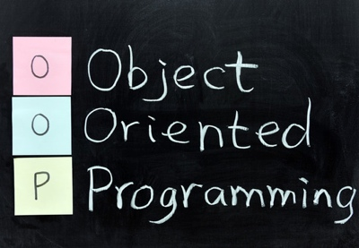

Introduction
Objects in School !!!!!

Slide 4












Slide 5
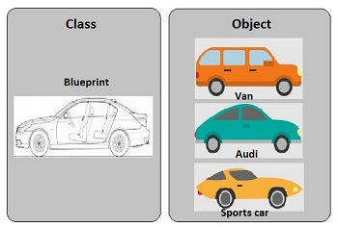
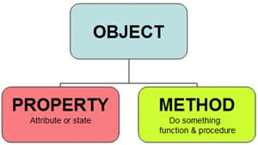
OOP Concepts

Slide 6
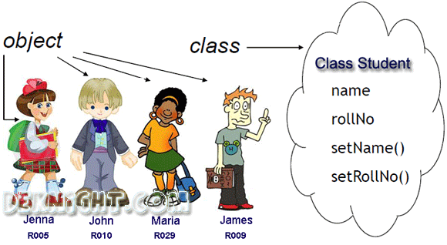

Slide 7

Notes:
Create 2 files 1 for class and 1 for run.
Self Keyword
Import from
Dot Operator
Call function print without calling set_name previously → Error.
So, Constructors.

Slide 8
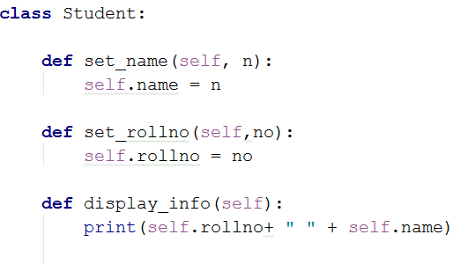
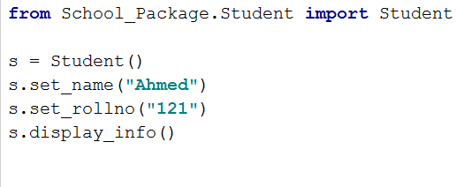
Student Class and Student Objects
Class Student
Student Object

Slide 9
Constructor
Constructor is a special method that is:
Automatically invoked right after the object is created
Usually sets the initial attributes values of the objects

Slide 11
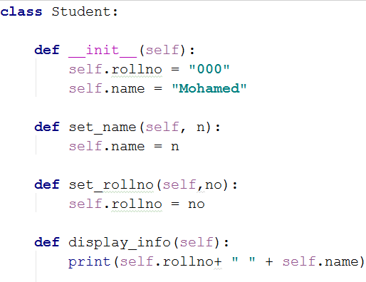
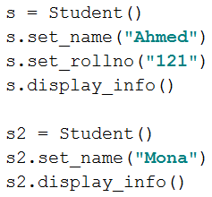
Student Class with constructors and Student Objects
Student Class
Student Object

Slide 12

Abstraction and Encapsulation
Abstraction is a process where you show only “relevant” data and “hide” unnecessary details of an object from the user.
Encapsulation is the process of combining data and functions into a single unit called class.
Notes:
Consider your mobile phone, you just need to know what buttons are to be pressed to send a message or make a call, What happens when you press a button, how your messages are sent, how your calls are connected is all abstracted away from the user.

Slide 13
Class Attributes Vs Instance Attributes
Assume you want to know the number of students objects created ??!!
Class Variables.
Class attributes are attributes which are owned by the class itself.
They will be shared by all the instances of the class. Therefore they have the same value for every instance
We define class attributes outside of all the methods, usually they are placed at the top, right below the class header

Slide 14
Class Methods Vs Instance methods
Class methods are methods that are bound to a class rather than its object.
The first parameter of a class method is a reference to a class (cls) and they depend on class attributes

Slide 15
Static Methods
This type of method takes neither a self nor a cls parameter
Therefore a static method can neither modify object state nor class state.
Static methods are restricted to their parameters.

Slide 16
Important Notes
Instance methods need a class instance and can access the instance through self.
Class methods don’t need a class instance. They can’t access the instance (self) but they have access to the class itself via cls.
Static methods don’t have access to cls or self. They work like regular functions but belong to the class’s namespace.

Slide 17
Notes:
Define Student_Counter as class attribute in the class
Add in the constructor

Slide 18
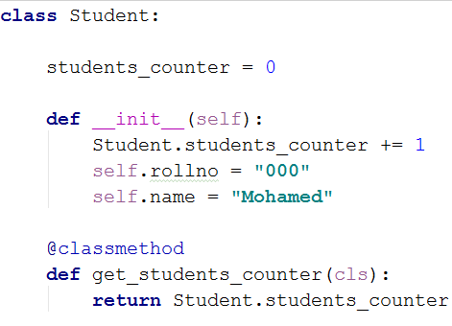
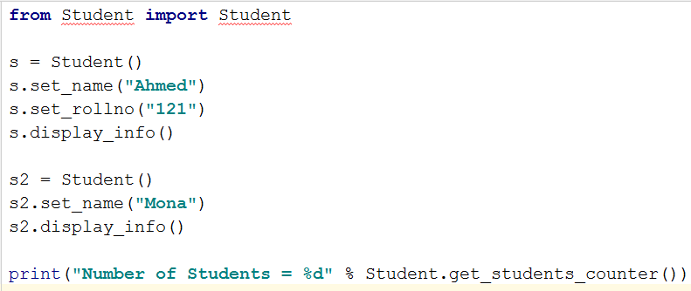
Class attributes and Class Methods
Student Class
Student Object

Slide 19
Objects’ Interaction
Assume we have a class book.
Assume each a student has an attribute favorite book ??!!
So, we need to add book attribute to constructor and add a new method describe_book () that prints student ‘s description about his favorite book.

Slide 21
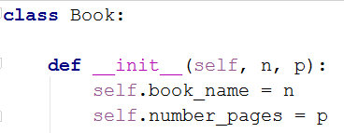
Student and Book Objects Interaction
Book Class

Slide 22
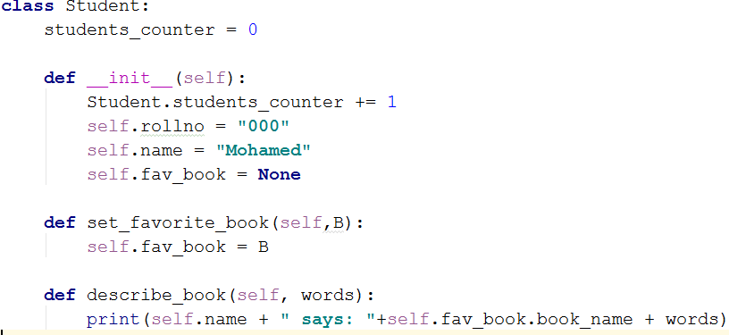
Student and Book Objects Interaction
Student Class

Slide 23
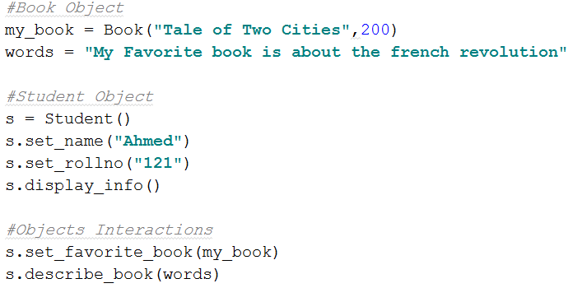
Student and Book Objects Interaction
Student and Book Objects

Slide 24
Rabbit Story using OOP
What are the available classes in our story ?
What is the number of objects in our story ?
Is there any objects’ interactions in our story ?

Slide 25
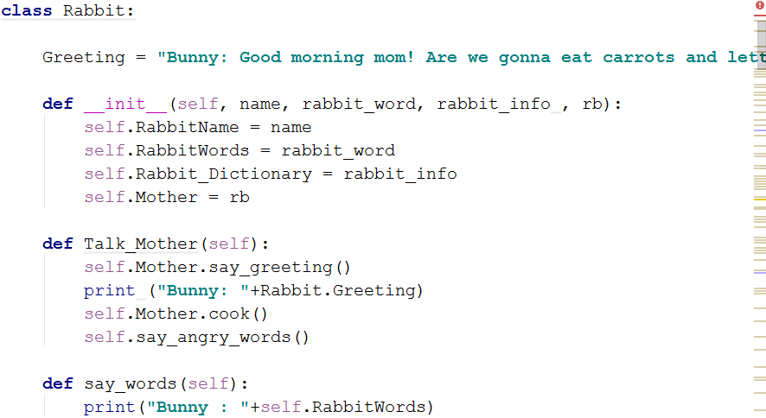
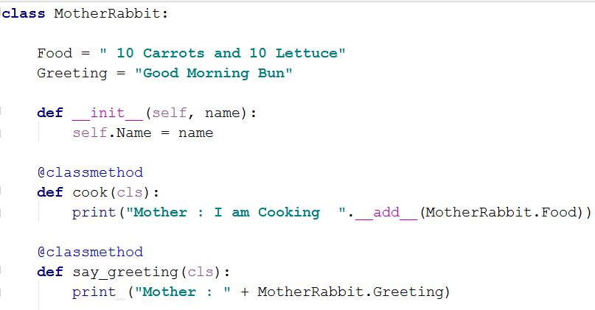
Classes in Rabbit Story
Rabbit
Mother_Rabbit

Slide 26
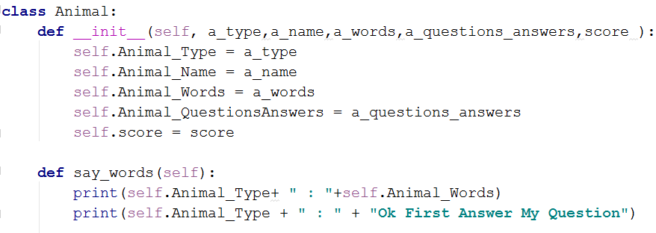
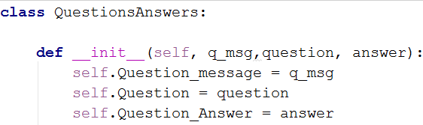
Classes in Rabbit Story
Animals
Questions_Answers

Slide 27
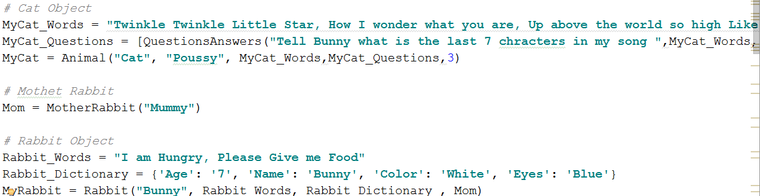
Objects in Rabbit Story

Slide 28
What is the main advantages of OOP? ☺ ☺
Organized and readable code
Code reuse
Encapsulation
Code maintenance

Slide 29
Extra Curriculum
Access Modifiers
Inheritance Concept
Overloading Concept

Slide 30


Slide 31


